Slide 1


模拟电子技术基础
Analog Device
2.2 Amplification circuits based on transistors 晶体管放大电路
Qingfeng Zhang 张青峰
电子与电气工程系 E³

Slide 2


2.2.1 What is amplification
Red Thunder
The requirement of amplification is: Non-distortion

Slide 3






2.2.2 Key parameters of amplifier circuit
In most cases, signal are AC.
Amplifier circuit
+
+
Load
R_{s}
R_{o}
Sine wave signal
负载
+
R_{i}
+
R_{L}
-
-
-
-
Output voltage of amplifier circuit
Input voltage of amplifier circuit
Input resistance of amplifier circuit
Output resistance of amplifier circuit

Slide 4
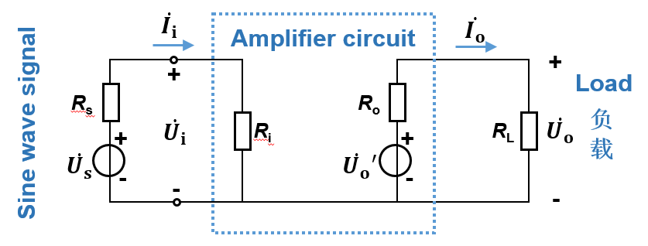
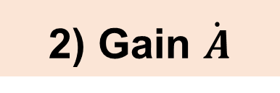
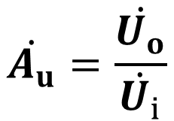
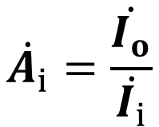
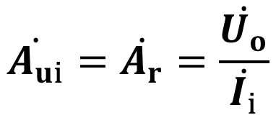
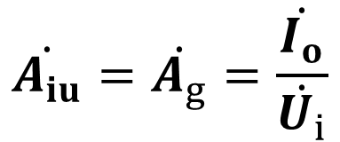
Voltage gain
Current gain
电压放大倍数
电流放大倍数
Transimpedance gain
互阻放大倍数
Transconductance gain
互导放大倍数

Slide 5
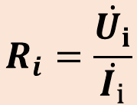
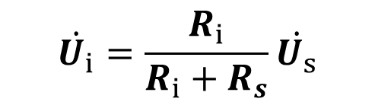
3) Input resistance R_{i}
多模态磁共振图像分析,
R_{i} ↑，U_{i} ↑ ，better performance

Slide 6
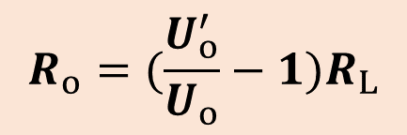
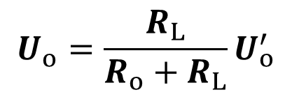
4) Output resistance
R_{o} is smaller，U_{o} is more stable，better load capacity

Slide 7

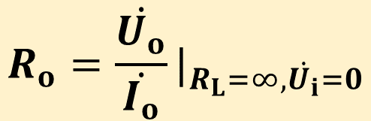

How to get output resistance?
Amplifier circuit
+
R_{o}
R_{s}
R_{i}
-

Slide 8
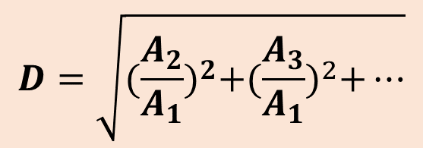
5) Nonlinear harmonic distortion coefficient
非线性(谐波)失真系数
Base wave
High-order harmonic wave
Distortion
+
+
+ …
A₂
A₃
A_{n}
A₁
Linear amplification

Slide 9
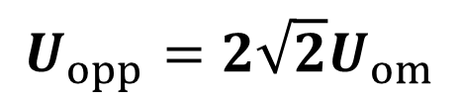
6) The maximum non-distortion output voltage 最大不失真输出电压
Peak-to-peak value U_{opp}, or Effective value U_{om}
Amplification
U_{opp}

Slide 10

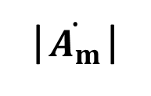
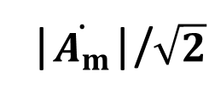
7) Bandwidth 频带宽度/通频带
There are always capacitance and inductance in the amplifier circuit. When frequency is too high or too low, the gain will decrease. In general, an amplifier circuit can only operate in a certain range of signal frequency.
Amplitude-frequency characteristics
f_{BW}
0
f_{L}
f_{H}
f
Lower cut-off frequency f_{L}
Upper cut-off frequency f_{H}
Bandwidth: f_{BW}= f_{H} - f_{L}

Slide 11
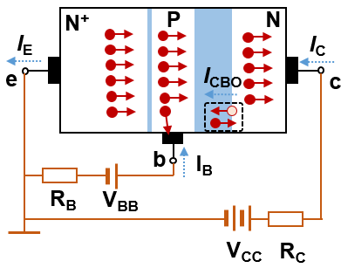
2.2.3 Common-emitter amplifier circuit
Static 静态 — no AC signal
I_{C}
c
I_{B}
R_{C}
b
e
R_{B}
R_{B}
+
I_{E}
V_{CC}
u_{i}=0
-
V_{BB}
There is only DC currents in circuits

Slide 12
Dynamic 动态 — when there is AC input signal
There are both DC and AC currents in circuits
Without load
With load
I_{C}
i_{c}
I_{C}
+
i_{c}
+
c
c
i_{b}
I_{B}
i_{b}
I_{B}
R_{C}
R_{C}
b
e
b
R_{B}
e
R_{L}
R_{B}
R_{B}
U_{O}+u_{o}
R_{B}
U_{O}+u_{o}
+
I_{E}
V_{CC}
+
I_{E}
V_{CC}
u_{i}
i_{e}
u_{i}
-
-
i_{e}
V_{BB}
V_{BB}
-
-

Slide 13
Problems of the circuit
I_{C}
i_{c}
+
c
1) Amplification circuit and signal source will interact.
i_{b}
I_{B}
R_{C}
b
e
R_{B}
R_{L}
R_{B}
U_{O}+u_{o}
+
I_{E}
V_{CC}
u_{i}
i_{e}
-
2) Amplification circuit and load resistor will interact.
V_{BB}
-

Slide 14
Improved amplification circuit:
C₂
+
C₁
T
R_{C}
R_{L}
u_{o}
+
R_{B}
u_{i}
V_{CC}
-
V_{BB}
-
Capacitor C₁ & C₂：
1) Separate signal and load from DC voltage and current.
2) AC signal can flow through capacitors.

Slide 15
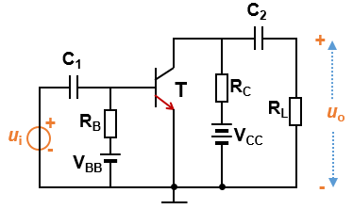
c
b
e
Provide reverse DC bias for BC junction.
V_{CC}
Provide energy for the amplifier circuit.
V_{BB}
R_{B}
Provide forward DC bias U_{BE} for BE junction
Provide base DC current I_{B}

Slide 16
c
b
e
Adjust the voltage drop on BC junction.
R_{C}
Transform current signal to voltage signal, and realize the amplification of voltage.

Slide 17
Simplify the circuit:
C₂
+
C₁
T
R_{C}
R_{L}
u_{o}
+
R_{B}
u_{i}
V_{CC}
-
V_{BB}
-

Slide 18














Three methods to draw a DC voltage source
Loop
Loop

Slide 19


C₂
Simplify the circuit
+
1
+V_{CC}
C₁
T
R_{C}
3
R_{B}
R_{C}
C₂
+
R_{L}
u_{o}
C₁
+
R_{B}
u_{i}
V_{CC}
T
-
+
R_{L}
u_{o}
V_{BB}
u_{i}
-
-
C₂
-
2
+
C₁
T
R_{C}
1
3
R_{L}
R_{B}
u_{o}
+
u_{i}
-
V_{CC}
-

Slide 20
V_{CC}
R_{B}
i_{C}
R_{C}
C₂
+
C₁
i_{B}
c
T
+
b
R_{L}
u_{o}
u_{i}
e
-
-

Slide 21





Signal flow in the circuit
Total
DC
AC
V_{CC}
R_{B}
i_{C}
R_{C}
C₂
+
C₁
i_{B}
c
T
+
b
R_{L}
u_{O}
u_{i}
e
-
-
Capacitor C₂

Slide 22


AC voltage/current：dynamic working parameter
交流电压/电流：动态工作参数
Signal.
DC voltage/current：static working parameter
直流电压/电流：静态工作参数
Make transistor work in amplification region.

Slide 23

To amplifier AC signal, transistor must work in amplification region.

Slide 24
Input curve of transistor
Output curve of transistor
I_{B}
I_{C}
I_{B}=80μA
60μA
Saturation
40μA
Amplification
20μA
U_{BE}
0μA
U_{ON}
U_{CE}
Cut-off
Choose V_{CC}, R_{B} and R_{C}, set a proper U_{BE}, U_{CE}, I_{C} and I_{B}, to make transistor work in the amplification region.

Slide 25



V
I provide the energy and proper static working point!
V_{CC}
I feel good!
R_{B}
R_{C}
C₂
+
C₁
c
I am signal
T
+
b
R_{L}
u_{O}
u_{i}
e
-
-
T
I am in amplification region!

Slide 26
Q: How to get the static and dynamic working parameters?
Separate DC and AC signals!

Slide 27
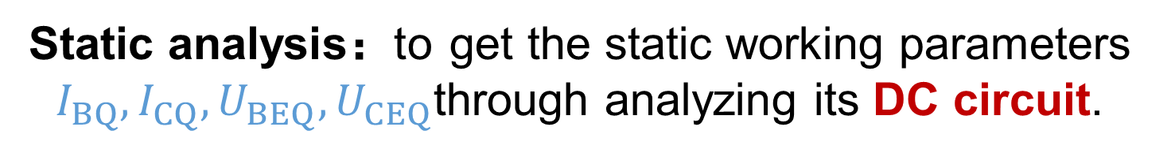
2.2.4 Static analysis of the amplification circuit
DC/static circuit
V_{CC}
V_{CC}
R_{B}
R_{C}
C₂
R_{B}
R_{C}
I_{C}
+
C₁
c
c
+
b
T
T
U_{CE}
+
b
R_{L}
u_{o}
I_{B}
u_{i}
e
e
-
-
-

Slide 28
Graphical method 图解法
1) Input circuit 输入回路
Input circuit equation
V_{CC}=I_{B}R_{B}+U_{BE}
V_{CC}
I_{B}
Input curve of transistor
三极管输入特性曲线
R_{B}
R_{C}
I_{C}
V_{CC}/R_{B}
c
+
b
T
U_{CEQ}
I_{B}
I_{BQ}
Q_{i}
DC load curve of input circuit
输入回路直流负载线
e
-
U_{BEQ}
V_{CC}
U_{BE}
The intersection point is called the input static working point Q_{i}. 交点叫做输入回路静态工作点。

Slide 29
2) Output circuit 输出回路
Output circuit equation:
V_{CC}=I_{C}R_{C}+U_{CE}
V_{CC}
I_{C}
R_{B}
R_{C}
I_{C}
V_{CC}/R_{C}
Output curve of transistor
c
+
Q_{o}
b
I_{CQ}
I_{BQ}
T
U_{CEQ}
I_{B}
e
DC load curve of output circuit
-
U_{CEQ}
V_{CC}
U_{CE}
The intersection point is called the output static working point Q_{o}.

Slide 30
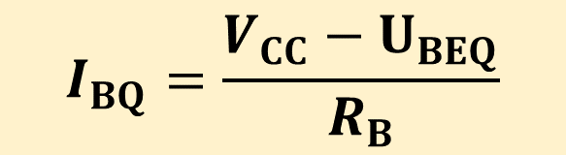

Parametric estimating method 估算法
1
Input circuit：
V_{CC}=I_{BQ}R_{B}+U_{BEQ}
V_{CC}
R_{B}
R_{C}
I_{C}
c
+
U_{BEQ}=0.7V for Si, 0.3V for Ge
b
T
U_{CE}
I_{B}
e
-
2
3
Output circuit
U_{CEQ}=V_{CC}-I_{CQ}R_{C}

Slide 31
2.2.5 Dynamic analysis of the amplification circuit
Dynamic analysis: analyze the AC signal based on the static circuit.
动态分析：在静态电路的基础上分析各交流信号的关系
V_{CC}
R_{B}
R_{C}
C₂
+
C₁
c
T
+
b
R_{L}
u_{o}
u_{i}
e
-
-

Slide 32
How to obtain the AC circuit
AC circuit 交流通路
V_{CC}
R_{B}
R_{C}
C₂
R_{B}
R_{C}
+
+
C₁
c
c
T
T
+
b
R_{L}
u_{o}
+
b
R_{L}
u_{o}
u_{i}
e
u_{i}
e
-
-
-
-
1. Short the DC voltage source (Connect DC voltage source to ground) 直流电压源接地.
2. Short the capacitor 电容短路.

Slide 33
AC circuit 交流通路
R_{B}
R_{C}
+
+
c
c
T
T
b
u_{o}
+
b
R_{C}
R_{L}
u_{o}
+
R_{L}
u_{i}
e
u_{i}
e
R_{B}
-
-
-
-

Slide 34
Graphic method for AC circuit 图解法

Slide 35
Input and output circuit equation of AC circuit 交流通路的输入与输出方程
Input circuit equation
i_{c}
+
u_{be} = u_{i}
i_{b}
c
T
+
b
R_{C}
R_{L}
u_{o}
u_{i}
R_{B}
e
Output circuit equation
-
i_{e}
-
u_{o}=u_{ce}=-i_{c}(R_{c}|| R_{L})

Slide 36
Input circuit equation: DC+AC
Static/DC circuit
Dynamic/AC circuit
V_{CC}
i_{c}
+
R_{B}
R_{C}
I_{C}
i_{b}
c
c
T
+
+
b
R_{C}
R_{L}
u_{o}
b
u_{i}
e
T
U_{CEQ}
R_{B}
i_{e}
I_{B}
-
e
-
-
Input circuit equation:
Input circuit equation:
V_{CC}=I_{B}R_{B}+U_{BE}
u_{be}=u_{i}
Total BE voltage:
u_{BE}=U_{BE}+u_{be}
u_{BE} =U_{BEQ}+u_{i}

Slide 37
Output circuit equation: DC+AC
Static/DC circuit
Dynamic/AC circuit
V_{CC}
i_{c}
+
R_{B}
R_{C}
I_{C}
i_{b}
c
c
T
+
+
b
R_{C}
R_{L}
u_{o}
b
u_{i}
e
T
U_{CEQ}
R_{B}
i_{e}
I_{B}
-
e
-
-
Output circuit:
Output circuit:
U_{CE}=V_{CC}-I_{C}R_{C}
u_{o}=u_{ce}=-i_{c}(R_{c}||R_{L})

Slide 38

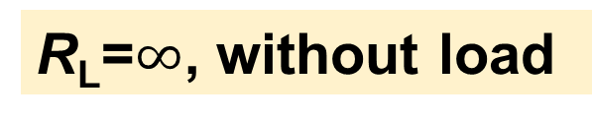


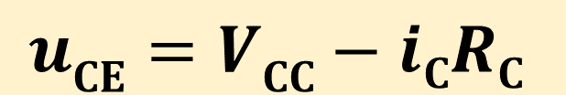
Output circuit equation: DC+AC circuits
Case 1:

Slide 39
2.2.6 Graphical method for analyzing AC signal
V_{CC}
Input circuit equation: DC+AC
R_{B}
R_{C}
C₂
+
u_{BE} =U_{BEQ}+u_{i}
C₁
c
T
Output circuit equation: DC+AC
+
b
R_{L}
u_{o}
u_{i}
e
u_{CE}=V_{CC}-i_{C}R_{C}
-
-
AC
AC
u_{i} → u_{be}
u_{BE} → i_{B} → i_{C} → u_{CE}
u_{ce} → u_{o}
U_{BEQ}
U_{CEQ}
DC
DC

Slide 40
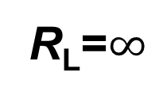

Case 1:
1) Input circuit
u_{BE}= U_{BEQ} + u_{i}
V_{CC}
R_{B}
R_{C}
C₂
u_{BE}
+
C₁
c
U_{BEQ}
T
+
b
u_{o}
u_{i}
e
u_{i}
-
0
-
t

Slide 41
i_{B}
Input curve of transistor
三极管输入特性曲线
i_{B}
i_{B}= I_{BQ} + i_{b}
I_{B1}
I_{BQ}
Q_{i}
I_{B2}
0
t₁
t₂
t₃
t
0
u_{BE}
t
t₃
t₂
t₁
0
u_{BE}
u_{BE}= U_{BEQ} + u_{i}

Slide 42
2) Output circuit
i_{C}= β i_{B}
i_{C}
i_{C}
i_{C}= I_{CQ} + i_{c}
i_{B}=I_{B1}
I_{C1}
Q_{o}
i_{B}=I_{BQ}
I_{CQ}
i_{B}=I_{B2}
I_{C2}
0
0
t
u_{CE}
t₁
t₂
t₃
t
t₃
t₂
u_{CE}=V_{CC}-i_{C}R_{C}
t₁
0
u_{CE}
u_{CE}= U_{CEQ} + u_{ce}

Slide 43
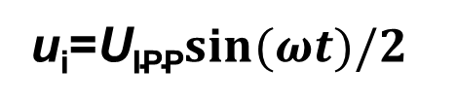
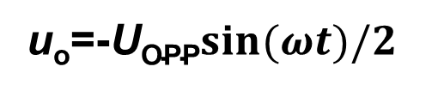
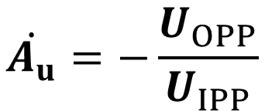
Input signal
Output signal
t
t
t₃
t₂
t₁
0
u_{i}
0
u_{o}
There is a 180º phase shift between input and output signal
Voltage gain 电压放大倍数：

Slide 44
3) Q point (Q_{i}&Q_{o}) is too low 静态工作点太低
i_{B}
i_{B}
Input circuit
i_{B}= I_{BQ} + i_{b}
I_{B1}
I_{BQ}
Q_{i}
I_{B2}
0
0
t₁
t₂
t₃
t
u_{BE}
t
t₃
Distortion!
t₂
t₁
0
u_{BE}
u_{BE}= U_{BEQ} + u_{i}

Slide 45
i_{C}
i_{C}
i_{B}=I_{B1}
I_{C1}
i_{B}=I_{BQ}
I_{CQ}
Q_{o}
0
i_{B}=I_{B2}
I_{C2}
t
u_{CE}
0
t₁
t₂
t₃
t
t₃
t₂
Cut-off distortion!
t₁
截止失真
0
u_{CE}
U_{CEQ}

Slide 46
4) Q point (Q_{i}&Q_{o}) is too high 静态工作点太高
i_{B}
i_{B}
I_{B1}
Q_{i}
I_{BQ}
I_{B2}
0
t₁
t₂
t₃
t
0
u_{BE}
t
t₃
Non-Distortion for input circuit
t₂
t₁
0
u_{BE}
u_{BE}= U_{BEQ} + u_{i}

Slide 47
i_{C}
i_{C}
i_{B}=I_{B1}
I_{C1}
Q_{o}
i_{B}=I_{BQ}
I_{CQ}
i_{B}=I_{B2}
I_{C2}
0
0
t
u_{CE}
t₁
t₂
t₃
t
t₃
t₂
Saturation distortion for output circuit!
t₁
0
饱和失真
U_{CEQ}
u_{CE}

Slide 48
5) Amplitude of input signal is too large
i_{B}= I_{BQ} + i_{b}
i_{B}
i_{B}
I_{B1}
I_{BQ}
Q_{i}
I_{B2}
0
t₁
t₂
t₃
t
0
u_{BE}
t
t₃
t₂
t₁
0
u_{BE}
u_{BE}= U_{BEQ} + u_{i}

Slide 49
i_{C}
i_{C}
i_{B}=I_{B1}
I_{C1}
Q_{o}
i_{B}=I_{BQ}
I_{CQ}
i_{B}=I_{B2}
I_{C2}
0
0
t
u_{CE}
t₁
t₂
t₃
t
t₃
t₂
Distortion!
t₁
0
u_{CE}
U_{CEQ}

Slide 50
6) Dynamic range 动态范围
The maximum non-distorted output voltage (peak-to-peak value U_{opp})
t
t₃
t₂
t₁
0
u_{CE}
U_{opp}

Slide 51
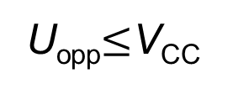
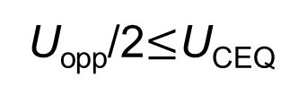
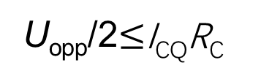
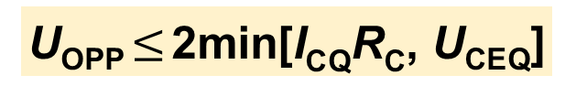
Dynamic range (ignore the saturation region)
i_{C}
V_{CC}=I_{C}R_{C}+U_{CEQ}
i_{C}
V_{CC}/R_{C}
Q_{o}
U_{CEQ}
I_{CQ}R_{C}
V_{CC}
0
0
t
u_{CE}
t₁
t₂
t₃
t
t₃
t₂
t₁
0
u_{CE}
U_{opp}

Slide 52
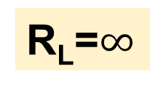
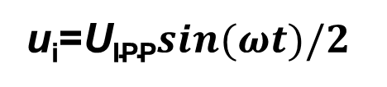
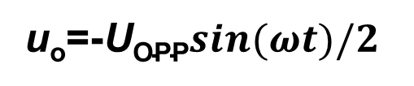
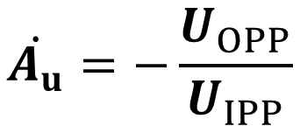
Conclusion:
Common-emitter amplification circuit
1. There is a 180º phase shift between input and output signal
Input signal
Output signal
t
t
t₃
t₂
t₁
0
u_{i}
0
u_{o}
Voltage gain:

Slide 53

2. Choose proper static working point Q_{i} and Q_{o}
Otherwise there is nonlinear distortion effect (saturation distortion, cutoff distortion)
u_{o}
cutoff distortion
3. The amplitude of output signal
saturation distortion
0
t

Slide 54
Case 2: R_{L} is finite
The output equation
u_{CE}=U_{CEQ}+u_{ce}
u_{CE}=V_{CC}-I_{CQ}R_{C}-i_{c}(R_{c}|| R_{L})
R_{L}’=R_{c}|| R_{L}
u_{CE}=V_{CC}-I_{CQ}R_{C}-i_{c}R_{L}’
=V_{CC}-I_{CQ}R_{C}+I_{CQ}R_{L}’-(I_{CQ}+i_{c})R_{L}’
=V_{CC}-I_{CQ}R_{C}+I_{CQ}R_{L}’-i_{C}R_{L}’
V_{CC}’ =V_{CC}-I_{CQ}R_{C}+I_{CQ}R_{L}’ =U_{CEQ}+I_{CQ}R_{L}’
u_{CE}=V_{CC}’-i_{C}R_{L}’

Slide 55

i_{C}
V_{CC}’/R_{L}’
Slope:1/R_{L}’
u_{CE}=V_{CC}-i_{C}R_{C}
V_{CC}/R_{C}
Slope:1/R_{C}
V_{CC} =U_{CEQ}+I_{CQ}R_{C}
R_{L} is finite
Q_{o}
u_{CE}=V_{CC}’-i_{C}R_{L}’
V_{CC}’ =U_{CEQ}+I_{CQ}R_{L}’
R_{L}’=R_{c}||R_{L}
0
u_{CE}
U_{CEQ}
V_{CC}’
V_{CC}
AC load curve 交流负载线

Slide 56
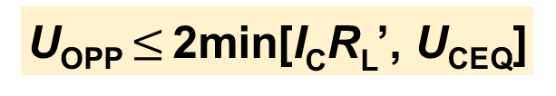

i_{C}
V_{CC}’/R_{L}’
Dynamic range:
Slope:1/R_{L}’
V_{CC}/R_{C}
Slope:1/R_{C}
Decrease
i_{B}=I_{B1}
Q_{o}
i_{B}=I_{BQ}
Decrease
i_{B}=I_{B2}
0
u_{CE}
U_{CEQ}
V_{CC}’
V_{CC}

Slide 57
i_{C}
V_{CC}’/R_{L}’
Slope:1/R_{L}’
V_{CC}/R_{C}
Slope:1/R_{C}
i_{B}=I_{B1}
Q_{o}
i_{B}=I_{BQ}
i_{B}=I_{B2}
0
u_{CE}
V_{CC}’
V_{CC}

Slide 58
2.2.7 Equivalent circuit method (h-model)
To replace transistor with a linear network
Transistor
Equivalent circuit
NPN or PNP
i_{B}
i_{C}
i_{B}
i_{C}
+
c
+
+
+
Linear network
u_{BE}
T
u_{BE}
u_{CE}
u_{CE}
b
–
–
–
–
e

Slide 59


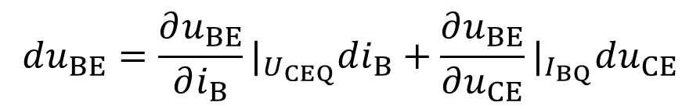
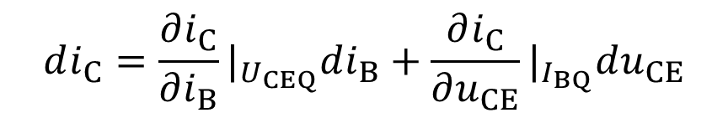
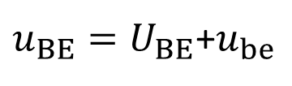

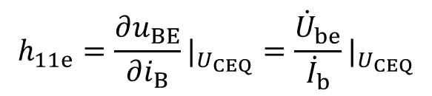
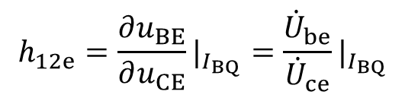
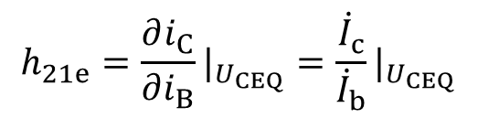
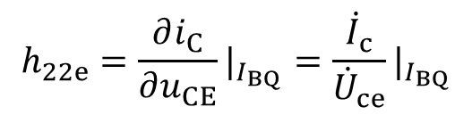
i_{B}
i_{C}
1
+
+
Linear network
u_{BE}
u_{CE}
–
–
2
Input signal u_{be} is small

Slide 60




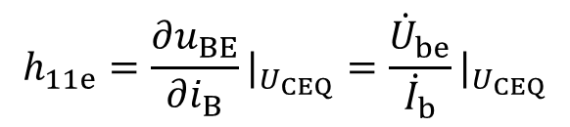
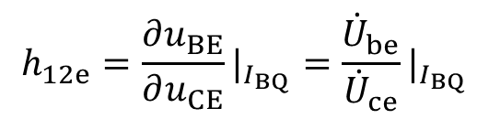
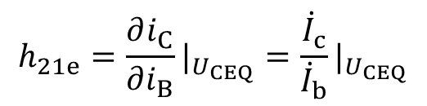
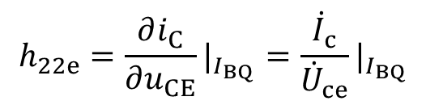
i_{B}
i_{C}
+
+
Linear network
u_{BE}
u_{CE}
–
–

Slide 61


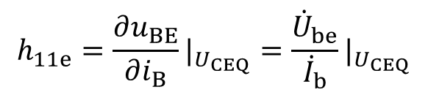
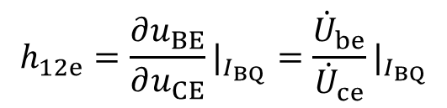
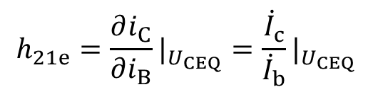
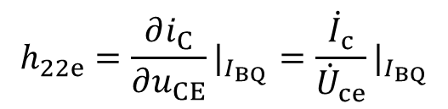
The physical interpretation of h
i_{B}
i_{B}
u_{CE}
Q_{i}
Q_{i}
0
0
u_{BE}
u_{BE}

Slide 62


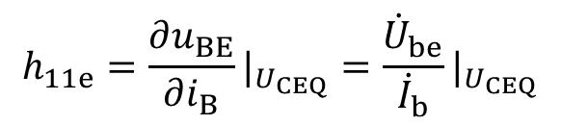



i_{C}
i_{C}
Q_{o}
Q_{o}
i_{B}=I_{BQ}
i_{B}=I_{BQ}
0
0
u_{CE}
u_{CE}

Slide 63
















Common-emitter
+
c
+
b
e
-
-
+
+
+
-
-
-

Slide 64


















+
+
+
-
-
-
Because h_{12e} and h_{22e} is very small, we can simplify the circuit
+
+
-
-

Slide 65





V_{CC}
Example:
R_{B}
R_{C}
C₂
+
C₁
c
T
+
b
R_{L}
e
-
-
What’s the equivalent circuit of h-model?
+
(1) AC circuit
c
T
+
b
R_{C}
R_{L}
R_{B}
e
-
-

Slide 66










+
(1) AC circuit
c
T
+
b
R_{C}
R_{L}
+
R_{B}
e
-
-
-
(2) h-model
+
+
+
+
R_{B}
R_{C}
R_{L}
-
-
-
-

Slide 67











+
+
R_{B}
R_{C}
R_{L}
-
-
Voltage gain：

Slide 68










+
+
R_{B}
R_{C}
R_{L}
-
-
Input resistance：

Slide 69


















+
+
R_{B}
R_{C}
R_{L}
-
-
Output resistance：
+
R_{B}
R_{C}
-
Current source has infinite resistance

Slide 70



-V_{CC}
R_{B}
R_{C}
(a) Static parameters: I_{BQ}, I_{CQ} and U_{CEQ};
I_{B}
I_{C}
C₂
+
C₁
c
T
(b) A_{u}, R_{i}, R_{o} and U_{opp}.
+
b
R_{L}
e
-
-

Slide 71






-V_{CC}
(a) I_{BQ}, I_{CQ} and U_{CEQ}.
R_{B}
R_{C}
I_{B}
I_{C}
C₂
-V_{CC}=-I_{BQ}R_{B}+U_{BEQ}
+
C₁
c
T
+
b
R_{L}
e
-
-
DC circuit
-V_{CC}
R_{B}
R_{C}
I_{C}
-V_{CC}=-I_{CQ}R_{C}+U_{CEQ}
c
+
b
T
U_{CE}
I_{B}
e
-

Slide 72








-V_{CC}
(b) A_{u}, R_{i}, R_{o} and U_{opp}.
R_{B}
R_{C}
C₂
+
C₁
c
T
AC circuit
+
+
b
R_{L}
c
e
-
T
+
b
R_{C}
R_{L}
-
R_{B}
e
-
-
h-model
+
+
R_{B}
R_{C}
R_{L}
-
-

Slide 73














(b) A_{u}, R_{i}, R_{o} and U_{opp}.
+
+
R_{B}
R_{C}
R_{L}
-
Voltage gain
-

Slide 74





+
(b) A_{u}, R_{i}, R_{o} and U_{opp}.
+
R_{B}
R_{C}
R_{L}
-
-
Input resistance:

Slide 75





+
(b) A_{u}, R_{i}, R_{o} and U_{opp}.
R_{B}
R_{C}
R_{L}
-
Output resistance:

Slide 76
Homework 2-1：
2.1，2.2，2.4

